Slide 1
UTLP Project
TEAM NAME : iNVICTUs
Team number : 4
Project title : Polling system
Team head : yupindra kumar b (ECE) - rec
Team members : Thamarai selvi m (IT) - RIT
Sheeba elsi s (IT) - RIT
keerthivasa t (EEE) - RIT
manoranjitha m (EEE) - RIT

Slide 2
ABSTRACT
This Project enables the user to cast their votes to their favourite candidate in an efficient and easy way.
The User will be provided with a set of statements asking him/her to touch the color corresponding to their choice.
Once the user has voted, a confirmation message is displayed stating that their votes have been taken into account.

Slide 3
Ulk interfaces involved
Graphical LCD
Character LCD
7 Segment Display
LED
Graphical LCD Touch

Slide 4
Ulk graphical lcd interfacing
This interface is used to display a set of 2 different colors.
Each color represents a particular political party. RED represents
ADMK, Yellow represents DMK and so on.

Slide 5
Ulk character lcd interfacing
The character LCD intimates the user about the color assigned to different parties.
It displays a statement asking the user to press a respective color for the party they are about to vote.
If it displays the message “Red for DMK”, it means that the user should touch the red color if he wants to vote for DMK.

Slide 6
ULK 7 SEGMENT DISPLAY INTERFACING
The 7 segment display is used to display the number of votes casted.
This means that, every time an user casts his vote, one count will be increased and this count will be displayed in the 7 segment LCD.
Thus the total number of voters can be known easily.

Slide 7
Ulk led interfacing
The LED is used to alert the user telling them if their vote is valid or not.
If the LED glows, it means that the user has voted.
Else, it means that the vote is not recognised. The user must try again.

Slide 8
ULK GLCD-TOUCH INTERFACING
This interface displays a set of 2 different colors.
Each color represents a particular political party. Here, RED represents ADMK and YELLOW represents DMK.
For every touch by the user, the vote count for the respective political party is increased.

Slide 9
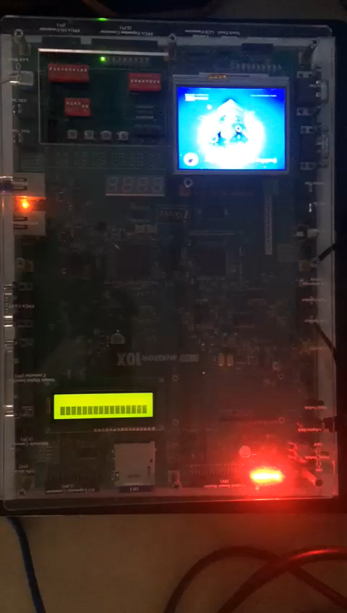
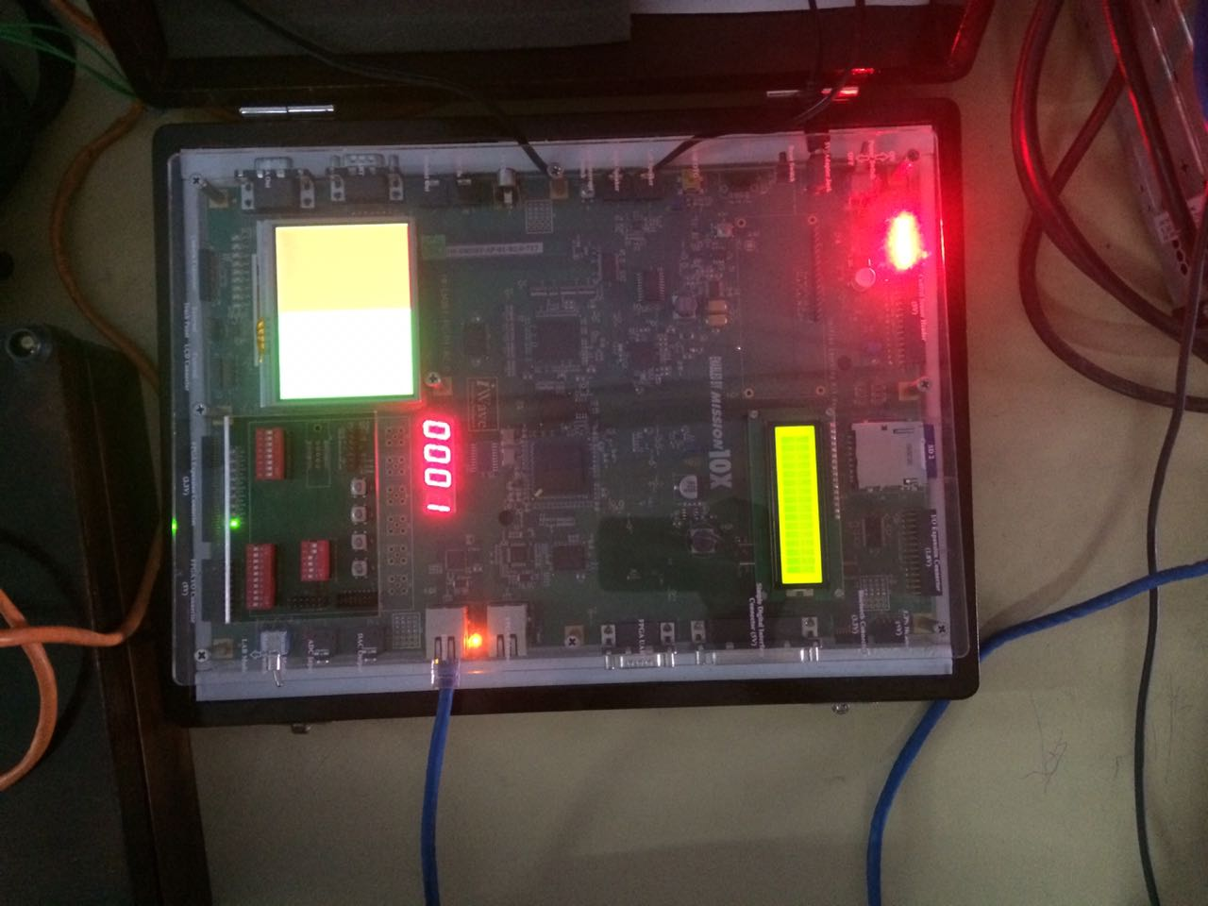
output

Slide 10
advantages
The total numbers of voters who have casted their votes is displayed and thus makes it easy to take a survey.
Easy and also secured way of voting.
Portable and easy to implement.

Slide 11
Future enhancements
In addition to the two basic political parties provided, all the current parties can be included in the CLCD display.
Every user will be provided with an ID. This will increase the security of the system.
The symbol of every party will be displayed and thus just by a touch on the symbol, the voters can vote.

Slide 12
THANK YOU

Slide 13
THANK YOU

